Slide 1


JENSON USA
Presentation
Presented By: Pavel Ghosh

Slide 2
Agenda
About the Company
Aim of the project
Problem statements
Queries
Key Insights
Recommendations
Connect With me

Slide 3

About The Company
We’ve all experienced the beauty of the trail or the freedom of the open road. For many, cycling presents a world of possibilities and opportunities at every turn. At Jenson USA, our passion for cycling sprouted back in 1994 and has since taken root and grown into a community of people devoted to living life to its fullest. We're building a culture of people who respect each other, set the pace, and lead through service. We strive daily to better serve our customers, our fellow employees, and our community. Over the years we’ve found that happy people are hardworking people, and that the time we spend on two wheels together builds the greatest profit of all.

Slide 4

Aim of the Project
As a data analyst at Jenson's, craft SQL queries to derive insights on customer behavior, staff performance, inventory management, and store operations.

Slide 5
Problem Statements
Find the total number of products sold by each store along with the store name.
Calculate the cumulative sum of quantities sold for each product over time.
Find the product with the highest total sales (quantity * price) for each category.
Find the customer who spent the most money on orders.
Find the highest-priced product for each category name.
Find the total number of orders placed by each customer per store.
Find the names of staff members who have not made any sales.
Find the top 3 most sold products in terms of quantity.
Find the median value of the price list.
List all products that have never been ordered.(use Exists)
List the names of staff members who have made more sales than the average number of sales by all staff members.
Identify the customers who have ordered all types of products (i.e., from every category).

Slide 6
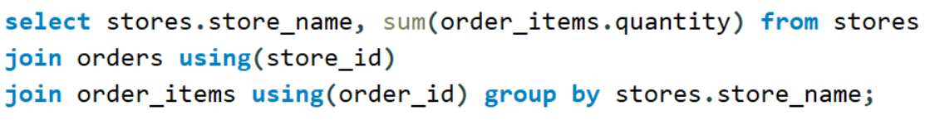
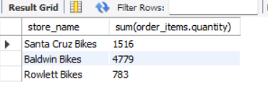
Find the total number of products sold by each store along with the store name.
Output

Slide 7
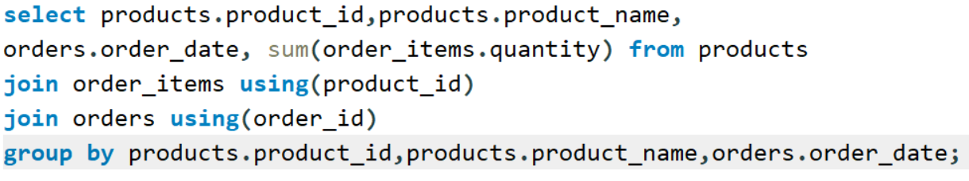
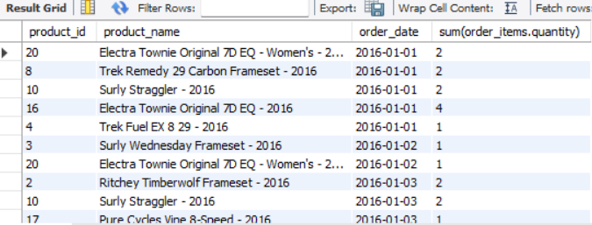
2. Calculate the cumulative sum of quantities sold for each product over time.
Output

Slide 8
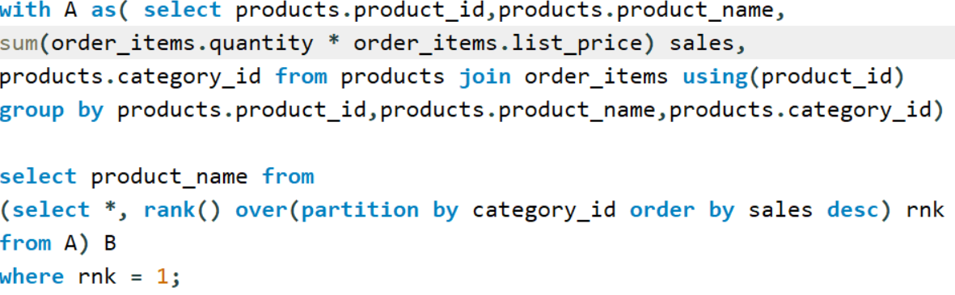
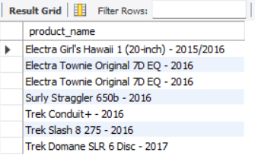
3. Find the product with the highest total sales (quantity * price) for each category.
Output

Slide 9
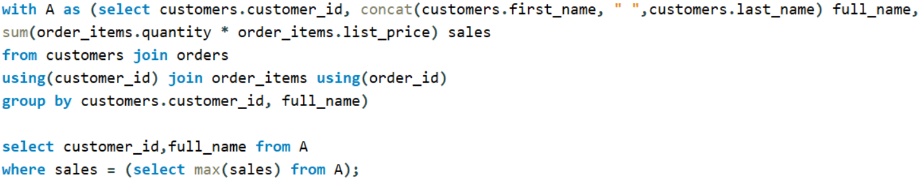
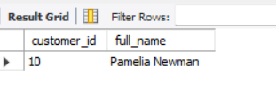
4. Find the customer who spent the most money on orders.
Output

Slide 10
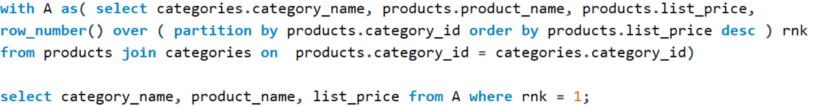
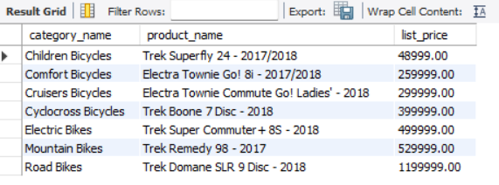
5. Find the highest-priced product for each category name.
Output

Slide 11
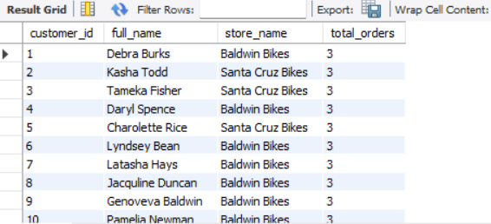
6. Find the total number of orders placed by each customer per store.
Output

Slide 12
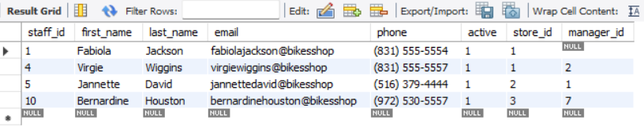
7. Find the names of staff members who have not made any sales.
Output

Slide 13
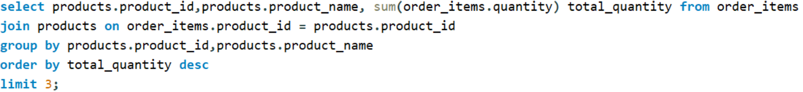
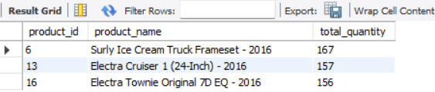
8. Find the top 3 most sold products in terms of quantity.
Output

Slide 14
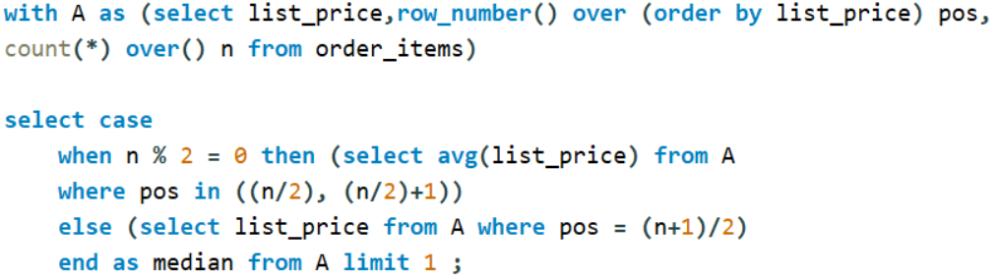
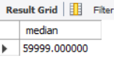
9. Find the median value of the price list.
Output

Slide 15
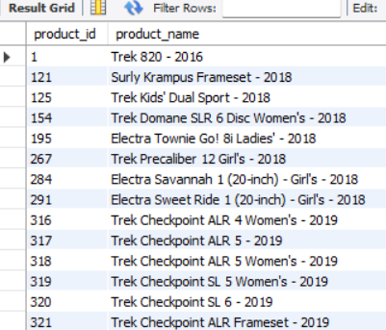
10.List all products that have never been ordered. (use Exists)
Output

Slide 16
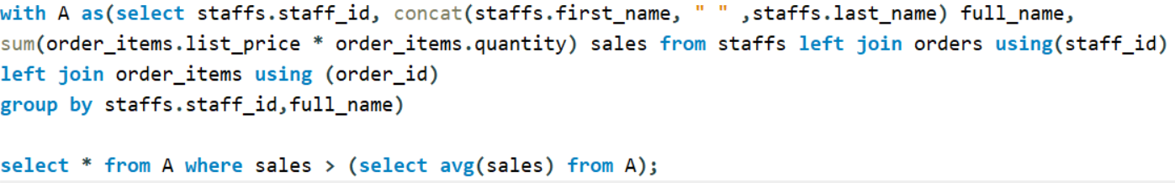
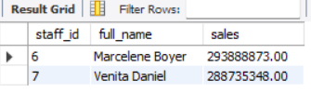
11. List the names of staff members who have
made more sales than the average number of
sales by all staff members.
Output

Slide 17

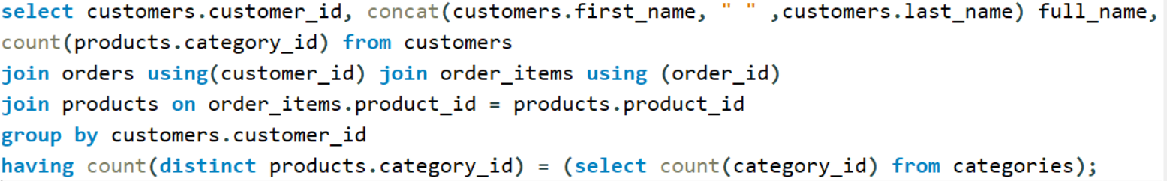
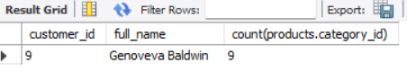
12. Identify the customers who have ordered all types of products (i.e., from every category).
Output

Slide 18
Key Insights
Store Performance: Each store’s total sales volume can be tracked
to identify top-performing locations.
Product Trends: Cumulative sales analysis reveals demand patterns over time.
Best Sellers: Top 3 most sold products highlight customer favorites.
Category Leaders: Identifies the highest revenue product in each category.
High-Value Customers: Pinpoints the customer who spent the most overall.
Customer Engagement: Shows number of orders per customer per store.
Staff Insights: Detects staff with no sales and those outperforming the average.
Product Gaps: Highlights products never ordered, helping optimize inventory.
Pricing Analysis: Median product pricing provides a benchmark for price strategy.
Customer Loyalty: Identifies customers who purchased across all categories.

Slide 19
Recommendations
Boost Top-Selling Products: Increase stock and promotion for the
top 3 products driving sales.
Improve Low-Performing Products: Reassess pricing, marketing, or
discontinue items never ordered.
Reward Loyal Customers: Create loyalty programs for customers purchasing across all categories.
Focus on High-Spending Customers: Offer personalized offers or premium services to maximize retention.
Staff Training & Incentives: Support staff with no sales and reward those exceeding average performance.
Optimize Store Operations: Replicate strategies from top-performing stores in underperforming ones.
Price Strategy Refinement: Use the median price insights to set competitive, profitable pricing.
Category Growth: Expand best-selling categories and innovate within slower-moving ones.

Slide 20
Thank You
For Your Attention

Slide 21





Connect With Me.
pavelghosh177@gmail.com
www.linkedin.com/in/ghosh-pavel
https://github.com/pavel-iso

